Slide 1
Image Model
Name | {Replace this with your name}
Identity Key | {Replace this with your identity key}
 | Level | Completed
 | Beginner | 0
 | Intermediate | 0
 | Advanced | 0
 | Expert | 0
Goal
4722 | 16
5722 | 18
Total Completed
0

Slide 2
Image Model
CSCI 5722/4722: Computer Vision
Spring 2024
Dr. Tom Yeh
Dr. Mehdi Moghari

Slide 3
ROC Curve

Slide 4
Discriminator = Binary Classifier
1*
1 | 0 | 1
0 | 1 | 1
1*
1 | 1 | -3
Pred
.7 | .1 | .5 | .7 | .1 | .3 | .7 | 0 | 0 | .1
Target
1 | 1 | 0 | 1 | 0 | 1 | 0 | 1 | 0 | 0

Slide 5
Threshold vs. TPR / FPR
.7 | .7 | .7 | .9 | 1 | 1 | 1
.5 | .5 | .5 | .7 | .9 | 1 | 1
.3 | .3 | .3 | .5 | .7 | .9 | 1
.1 | .1 | .1 | .3 | .5 | .7 | .9
0 | 0 | 0 | .1 | .3 | .5 | .7
0 | 0 | 0 | .1 | .3 | .5 | .7
0 | 0 | 0 | .1 | .3 | .5 | .7
.7 | .7 | .7 | .9 | 1 | 1 | 1
.5 | .5 | .5 | .7 | .9 | 1 | 1
.3 | .3 | .3 | .5 | .7 | .9 | 1
.1 | .1 | .1 | .3 | .5 | .7 | .9
0 | 0 | 0 | .1 | .3 | .5 | .7
0 | 0 | 0 | .1 | .3 | .5 | .7
0 | 0 | 0 | .1 | .3 | .5 | .7
.7 | .7 | .7 | .9 | 1 | 1 | 1
.5 | .5 | .5 | .7 | .9 | 1 | 1
.3 | .3 | .3 | .5 | .7 | .9 | 1
.1 | .1 | .1 | .3 | .5 | .7 | .9
0 | 0 | 0 | .1 | .3 | .5 | .7
0 | 0 | 0 | .1 | .3 | .5 | .7
0 | 0 | 0 | .1 | .3 | .5 | .7
.7 | .7 | .7 | .9 | 1 | 1 | 1
.5 | .5 | .5 | .7 | .9 | 1 | 1
.3 | .3 | .3 | .5 | .7 | .9 | 1
.1 | .1 | .1 | .3 | .5 | .7 | .9
0 | 0 | 0 | .1 | .3 | .5 | .7
0 | 0 | 0 | .1 | .3 | .5 | .7
0 | 0 | 0 | .1 | .3 | .5 | .7
+
+
+
+
+
+
+
+
_
_
_
_
+
+
+
+
_
_
_
_
_
_
_
_
+
+
+
+
_
_
_
_
_
_
_
_
+
+
+
+

Slide 6
Threshold vs. TPR / FPR
.7 | .7 | .7 | .9 | 1 | 1 | 1
.5 | .5 | .5 | .7 | .9 | 1 | 1
.3 | .3 | .3 | .5 | .7 | .9 | 1
.1 | .1 | .1 | .3 | .5 | .7 | .9
0 | 0 | 0 | .1 | .3 | .5 | .7
0 | 0 | 0 | .1 | .3 | .5 | .7
0 | 0 | 0 | .1 | .3 | .5 | .7
.7 | .7 | .7 | .9 | 1 | 1 | 1
.5 | .5 | .5 | .7 | .9 | 1 | 1
.3 | .3 | .3 | .5 | .7 | .9 | 1
.1 | .1 | .1 | .3 | .5 | .7 | .9
0 | 0 | 0 | .1 | .3 | .5 | .7
0 | 0 | 0 | .1 | .3 | .5 | .7
0 | 0 | 0 | .1 | .3 | .5 | .7
.7 | .7 | .7 | .9 | 1 | 1 | 1
.5 | .5 | .5 | .7 | .9 | 1 | 1
.3 | .3 | .3 | .5 | .7 | .9 | 1
.1 | .1 | .1 | .3 | .5 | .7 | .9
0 | 0 | 0 | .1 | .3 | .5 | .7
0 | 0 | 0 | .1 | .3 | .5 | .7
0 | 0 | 0 | .1 | .3 | .5 | .7
.7 | .7 | .7 | .9 | 1 | 1 | 1
.5 | .5 | .5 | .7 | .9 | 1 | 1
.3 | .3 | .3 | .5 | .7 | .9 | 1
.1 | .1 | .1 | .3 | .5 | .7 | .9
0 | 0 | 0 | .1 | .3 | .5 | .7
0 | 0 | 0 | .1 | .3 | .5 | .7
0 | 0 | 0 | .1 | .3 | .5 | .7
+
+
+
+
+
+
+
+
_
_
_
_
+
+
+
+
_
_
_
_
_
_
_
_
+
+
+
+
_
_
_
_
_
_
_
_
+
+
+
+

Slide 7

>=.7
>=.5
>=.3
+
+
+
_
_
.5 | .5 | .7 | .9 | .7
.3 | .3 | .5 | .7 | .5
.1 | .1 | .3 | .5 | .3
0 | 0 | .1 | .3 | .1
0 | 0 | 0 | .1 | 0
_
_
_
_
+
.5 | .5 | .7 | .9 | .7
.3 | .3 | .5 | .7 | .5
.1 | .1 | .3 | .5 | .3
0 | 0 | .1 | .3 | .1
0 | 0 | 0 | .1 | 0
.5 | .5 | .7 | .9 | .7
.3 | .3 | .5 | .7 | .5
.1 | .1 | .3 | .5 | .3
0 | 0 | .1 | .3 | .1
0 | 0 | 0 | .1 | 0
+
+
_
_
_
+
+
+
+
+
+
_
_
_
_
_
_
a
b
c
TPR = _________
FPR = _________
TPR = _________
FPR = _________
TPR = _________
FPR = _________
d
e
f
🔑 a+b+c = 2.25; d+e+f = 1

Slide 8
Receiver Operating Characteristic (ROC) Curve

Slide 9
Area Under ROC Curve (AUC)

Slide 10
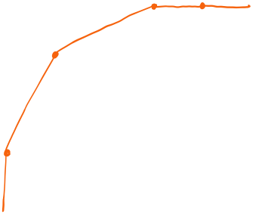
Calculate the improvement in AUC
a
Answer = _______________
🔑 a mod 7 = 3

Slide 11
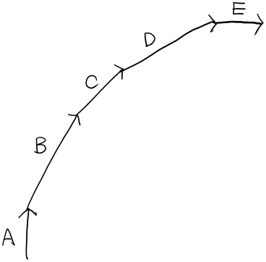
Match each movement segment to the correct interpretation of the changes in TP and FP
More true positives but at the cost of a lot more false positives.
More true positives without any new false positives.
No more true positives, just more false positives.
More true positives, but at the cost of about the same number of false positives.
More true positives at the cost of additional, but relatively fewer false positives.
TPR
FPR

Slide 12
Probabilities

Slide 13
1: Correct, 0: Incorrect
A. How are you?
B. How do you do?
C. Howdy?
D. How are you doing?
E. How is you?
F. How am you?

Slide 14
3: very high, 2: high, 1: low, 0: wrong
A. How are you?
B. How do you do?
C. Howdy?
D. How are you doing?
E. How is you?
F. How am you?

Slide 15
Context: Texas +2
 | A. How are you? | 3
 | B. How do you do? | 2
 | C. Howdy? | 1
 | D. How are you doing? | 3
 | A. How are you? | 3
 | B. How do you do? | 2
 | C. Howdy? | 1
 | D. How are you doing? | 3

Slide 16
Context: Formal +1, Texas +2
 | Texas | A. How are you? | 3
 |  | B. How do you do? | 2
 |  | C. Howdy? | 1
 |  | D. How are you doing? | 3
 | !Texas | A. How are you? | 3
 |  | B. How do you do? | 2
 |  | C. Howdy? | 1
 |  | D. How are you doing? | 3
 | Texas | A. How are you? | 3
 |  | B. How do you do? | 2
 |  | C. Howdy? | 1
 |  | D. How are you doing? | 3
 | !Texas | A. How are you? | 3
 |  | B. How do you do? | 2
 |  | C. Howdy? | 1
 |  | D. How are you doing? | 3

Slide 17
Language Model: Input and Output
L M

Slide 18
Aggregate
Formal | Texas | A. How are you? | 3
 |  | B. How do you do? | 3
 |  | C. Howdy? | 3
 |  | D. How are you doing? | 3
 | !Texas | A. How are you? | 3
 |  | B. How do you do? | 3
 |  | C. Howdy? | 1
 |  | D. How are you doing? | 3
!Formal | Texas | A. How are you? | 3
 |  | B. How do you do? | 2
 |  | C. Howdy? | 2
 |  | D. How are you doing? | 3
 | !Texas | A. How are you? | 3
 |  | B. How do you do? | 2
 |  | C. Howdy? | 1
 |  | D. How are you doing? | 3

Slide 19
Joint probability
Formal | Texas | A. How are you? | 3
 |  | B. How do you do? | 3
 |  | C. Howdy? | 3
 |  | D. How are you doing? | 3
 | !Texas | A. How are you? | 3
 |  | B. How do you do? | 3
 |  | C. Howdy? | 1
 |  | D. How are you doing? | 3
12
22
10
!Formal | Texas | A. How are you? | 3
 |  | B. How do you do? | 2
 |  | C. Howdy? | 2
 |  | D. How are you doing? | 3
 | !Texas | A. How are you? | 3
 |  | B. How do you do? | 2
 |  | C. Howdy? | 1
 |  | D. How are you doing? | 3
10
41
19
9

Slide 20
Conditional probability
Formal | Texas | A. How are you? | 3 | 3/41
 |  | B. How do you do? | 3 | 3/41
 |  | C. Howdy? | 3 | 3/41
 |  | D. How are you doing? | 3 | 3/41
 | !Texas | A. How are you? | 3 | 3/41
 |  | B. How do you do? | 3 | 3/41
 |  | C. Howdy? | 1 | 1/41
 |  | D. How are you doing? | 3 | 3/41
12
22
10
!Formal | Texas | A. How are you? | 3 | 3/41
 |  | B. How do you do? | 2 | 2/41
 |  | C. Howdy? | 2 | 2/41
 |  | D. How are you doing? | 3 | 3/41
 | !Texas | A. How are you? | 3 | 3/41
 |  | B. How do you do? | 2 | 2/41
 |  | C. Howdy? | 1 | 1/41
 |  | D. How are you doing? | 3 | 3/41
10
41
19
9

Slide 21
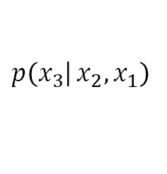
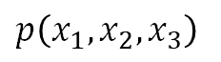
Joint probability
$$p\left(\left.x_{3}\right|{x_{2},x_{1}}\right)$$
$$p\left(x_{1},x_{2},x_{3}\right)$$
Formal | Texas |  |  | A. How are you? | 3 | 3/41 | 3/12
 |  |  |  | B. How do you do? | 3 | 3/41 | 3/12
 |  |  |  | C. Howdy? | 3 | 3/41 | 3/12
 |  |  |  | D. How are you doing? | 3 | 3/41 | 3/12
 | !Texas |  |  | A. How are you? | 3 | 3/41 | 3/10
 |  |  |  | B. How do you do? | 3 | 3/41 | 3/10
 |  |  |  | C. Howdy? | 1 | 1/41 | 1/10
 |  |  |  | D. How are you doing? | 3 | 3/41 | 3/10
12
22
10
!Formal | Texas |  |  | A. How are you? | 3 | 3/41 | 3/10
 |  |  |  | B. How do you do? | 2 | 2/41 | 2/10
 |  |  |  | C. Howdy? | 2 | 2/41 | 2/10
 |  |  |  | D. How are you doing? | 3 | 3/41 | 3/10
 | !Texas |  |  | A. How are you? | 3 | 3/41 | 3/9
 |  |  |  | B. How do you do? | 2 | 2/41 | 2/9
 |  |  |  | C. Howdy? | 1 | 1/41 | 1/9
 |  |  |  | D. How are you doing? | 3 | 3/41 | 3/9
10
41
19
9

Slide 22
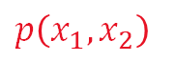
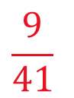
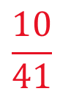
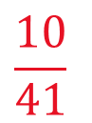
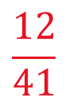
Conditional probability
$$p\left(\left.x_{3}\right|{x_{2},x_{1}}\right)$$
$$p\left(x_{1},x_{2}\right)$$
$$p\left(x_{1},x_{2},x_{3}\right)$$
Formal | Texas |  |  | A. How are you? | 3 | 3/41 | 3/12
 |  |  |  | B. How do you do? | 3 | 3/41 | 3/12
 |  |  |  | C. Howdy? | 3 | 3/41 | 3/12
 |  |  |  | D. How are you doing? | 3 | 3/41 | 3/12
 | !Texas |  |  | A. How are you? | 3 | 3/41 | 3/10
 |  |  |  | B. How do you do? | 3 | 3/41 | 3/10
 |  |  |  | C. Howdy? | 1 | 1/41 | 1/10
 |  |  |  | D. How are you doing? | 3 | 3/41 | 3/10
$$\frac{12}{41}$$
12
$$\frac{10}{41}$$
22
10
!Formal | Texas |  |  | A. How are you? | 3 | 3/41 | 3/10
 |  |  |  | B. How do you do? | 2 | 2/41 | 2/10
 |  |  |  | C. Howdy? | 2 | 2/41 | 2/10
 |  |  |  | D. How are you doing? | 3 | 3/41 | 3/10
 | !Texas |  |  | A. How are you? | 3 | 3/41 | 3/9
 |  |  |  | B. How do you do? | 2 | 2/41 | 2/9
 |  |  |  | C. Howdy? | 1 | 1/41 | 1/9
 |  |  |  | D. How are you doing? | 3 | 3/41 | 3/9
$$\frac{10}{41}$$
10
$$\frac{9}{41}$$
41
19
9

Slide 23
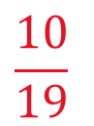
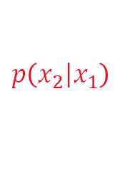
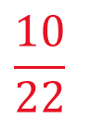
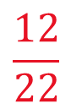
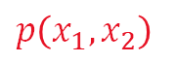
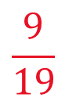
Probability
$$p\left(\left.x_{2}\right|x_{1}\right)$$
$$p\left(\left.x_{3}\right|{x_{2},x_{1}}\right)$$
$$p\left(x_{1},x_{2}\right)$$
$$p\left(x_{1},x_{2},x_{3}\right)$$
Formal |  | Texas |  |  | A. How are you? | 3 | 3/41 | 3/12
 |  |  |  |  | B. How do you do? | 3 | 3/41 | 3/12
 |  |  |  |  | C. Howdy? | 3 | 3/41 | 3/12
 |  |  |  |  | D. How are you doing? | 3 | 3/41 | 3/12
 |  | !Texas |  |  | A. How are you? | 3 | 3/41 | 3/10
 |  |  |  |  | B. How do you do? | 3 | 3/41 | 3/10
 |  |  |  |  | C. Howdy? | 1 | 1/41 | 1/10
 |  |  |  |  | D. How are you doing? | 3 | 3/41 | 3/10
$$\frac{12}{41}$$
$$\frac{12}{22}$$
12
$$\frac{10}{41}$$
$$\frac{10}{22}$$
22
10
!Formal |  | Texas |  |  | A. How are you? | 3 | 3/41 | 3/10
 |  |  |  |  | B. How do you do? | 2 | 2/41 | 2/10
 |  |  |  |  | C. Howdy? | 2 | 2/41 | 2/10
 |  |  |  |  | D. How are you doing? | 3 | 3/41 | 3/10
 |  | !Texas |  |  | A. How are you? | 3 | 3/41 | 3/9
 |  |  |  |  | B. How do you do? | 2 | 2/41 | 2/9
 |  |  |  |  | C. Howdy? | 1 | 1/41 | 1/9
 |  |  |  |  | D. How are you doing? | 3 | 3/41 | 3/9
$$\frac{10}{41}$$
$$\frac{10}{19}$$
10
$$\frac{9}{41}$$
$$\frac{9}{19}$$
41
19
9

Slide 24
Calculate Joint Probabilities p(x₁, x₂)
x₁
x₂
Freq
p(x₁, x₂)
!Angry | A. woof | 40
 | B. growl | 20
 | C. bark | 20
Angry | A. woof | 4
 | B. growl | 8
 | C. bark | 8
a
b
🐶
c
d
e
f
🔑 a+b+c+d+e+f = 1; b + d + f = .32

Slide 25
Calculate Conditional Probabilities p(x₂|x₁)
x₁
x₂
Freq
p(x₂ | x₁)
!Angry | A. woof | 40
 | B. growl | 20
 | C. bark | 20
Angry | A. woof | 4
 | B. growl | 8
 | C. bark | 8
a
b
🐶
c
d
e
f
🔑 a+b+c+d+e+f = 2; b + d + f = .85

Slide 26
Calculate p(home?)
(Simplify the fractions)
!Home | !Angry | A. woof | 3
 |  | B. growl | 2
 |  | C. bark | 5
 | Angry | A. woof | 1
 |  | B. growl | 3
 |  | C. bark | 1
a
p(home) =
🏠🐶
p(!home) =
b
Home | !Angry | A. woof | 12
 |  | B. growl | 4
 |  | C. bark | 4
 | Angry | A. woof | 2
 |  | B. growl | 5
 |  | C. bark | 3
🔑 numerator(a) + denominator(b) = 4 5; a + b = 1

Slide 27
Calculate p(angry? | home?)
(Simplify the fractions)
!Home | !Angry | A. woof | 3
 |  | B. growl | 2
 |  | C. bark | 5
 | Angry | A. woof | 1
 |  | B. growl | 3
 |  | C. bark | 1
a
p(angry| !home) =
🏠🐶
p(!angry| home) =
b
Home | !Angry | A. woof | 12
 |  | B. growl | 4
 |  | C. bark | 4
 | Angry | A. woof | 2
 |  | B. growl | 5
 |  | C. bark | 3
🔑 numerator(a) + denominator(b) = 4; a + b = 1

Slide 28
Calculate p(angry?, home?)
(Simplify the fractions)
!Home | !Angry | A. woof | 3
 |  | B. growl | 2
 |  | C. bark | 5
 | Angry | A. woof | 1
 |  | B. growl | 3
 |  | C. bark | 1
a
p(angry, !home) =
🏠🐶
p(!angry, home) =
b
Home | !Angry | A. woof | 12
 |  | B. growl | 4
 |  | C. bark | 4
 | Angry | A. woof | 2
 |  | B. growl | 5
 |  | C. bark | 3
🔑 (a + b) * 153 % 13 = 7

Slide 29
Calculate p(sound?, angry?, home?)
(Simplify the fractions)
!Home | !Angry | A. woof | 3
 |  | B. growl | 2
 |  | C. bark | 5
 | Angry | A. woof | 1
 |  | B. growl | 3
 |  | C. bark | 1
a
p(growl, angry, !home) =
b
p(woof, angry, !home) =
🏠🐶
c
Home | !Angry | A. woof | 12
 |  | B. growl | 4
 |  | C. bark | 4
 | Angry | A. woof | 2
 |  | B. growl | 5
 |  | C. bark | 3
p(woof, angry, home) =
d
p(bark, !angry, home) =
🔑 numerator(a) + denominator(b) + numerator(c) + denominator(d) = 93

Slide 30
Calculate p(sound? | angry?, home?)
(Simplify the fractions)
!Home | !Angry | A. woof | 3
 |  | B. growl | 2
 |  | C. bark | 5
 | Angry | A. woof | 1
 |  | B. growl | 3
 |  | C. bark | 1
a
p(growl| angry, !home) =
b
p(woof| angry, !home) =
🏠🐶
c
Home | !Angry | A. woof | 12
 |  | B. growl | 4
 |  | C. bark | 4
 | Angry | A. woof | 2
 |  | B. growl | 5
 |  | C. bark | 3
p(woof| angry, home) =
d
p(bark| !angry, home) =
🔑 numerator(a) + denominator(b) + numerator(c) + denominator(d) = 14

Slide 31
The Chain Rule of Probabilities

Slide 32
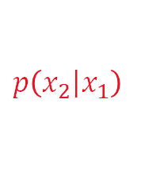
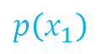
Conditional → Joint Probabilities
$$p\left(\left.x_{3}\right|{x_{2},x_{1}}\right)$$
$$p\left(\left.x_{2}\right|x_{1}\right)$$
$$p\left(x_{1}\right)$$
$$p\left(x_{1},x_{2}\right)$$
$$p\left(x_{1},x_{2},x_{3}\right)$$
Formal |  | Texas |  |  | A. How are you? | 3 | 3/41 | 3/12
 |  |  |  |  | B. How do you do? | 3 | 3/41 | 3/12
 |  |  |  |  | C. Howdy? | 3 | 3/41 | 3/12
 |  |  |  |  | D. How are you doing? | 3 | 3/41 | 3/12
 |  | !Texas |  |  | A. How are you? | 3 | 3/41 | 3/10
 |  |  |  |  | B. How do you do? | 3 | 3/41 | 3/10
 |  |  |  |  | C. Howdy? | 1 | 1/41 | 1/10
 |  |  |  |  | D. How are you doing? | 3 | 3/41 | 3/10
$$\frac{12}{41}$$
$$\frac{12}{22}$$
12
$$\frac{10}{41}$$
$$\frac{10}{22}$$
22
10

Slide 33
Tree Representation
A | 0.25
B | 0.25
C | 0.25
D | 0.25
Y
N
A | 0.3
B | 0.3
C | 0.1
D | 0.3
Y
N
A | 0.3
B | 0.2
C | 0.2
D | 0.3
Y
N
A | 0.33
B | 0.22
C | 0.11
D | 0.33

Slide 34
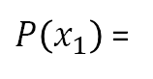
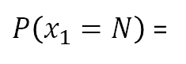
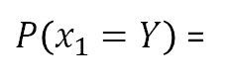
Probability Distribution vs. Values
$P\left(x_{1}\right)$ =
Y | 0.54
N | 0.46
$P\left(x_{1}=Y\right)$ =
$P\left(x_{1}=N\right)$ =

Slide 35
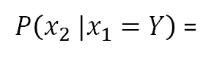
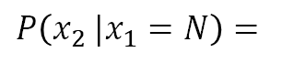
Conditional Probability Distributions
$P\left(x_{2} |x_{1}=Y\right)$ =
Y | 0.55
N | 0.45
Y | 0.54
N | 0.46
$$P\left(x_{2} |x_{1}=N\right)=$$
Y | 0.53
N | 0.47

Slide 36
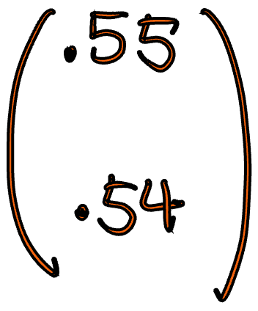
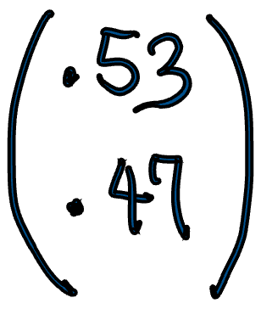
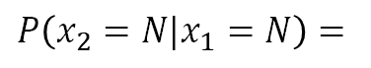
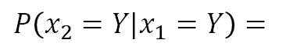
Conditional Probability Values
$P\left(x_{2} |x_{1}=Y\right)$ =
$$P\left(x_{2}=Y|x_{1}=Y\right)=$$
Y | 0.55
N | 0.45
Y | 0.54
N | 0.46
$$P\left(x_{2} |x_{1}=N\right)=$$
$$P\left(x_{2}=N|x_{1}=N\right)=$$
Y | 0.53
N | 0.47

Slide 37
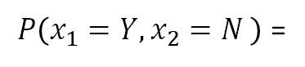
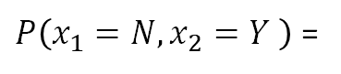
Joint Probability “Values” by the Chain Rule
Joint Probability of x1, x2
= p(________, ________)
= p(__________) x p(__________)
Y | 0.55
N | 0.45
Y | 0.54
N | 0.46
$P\left(x_{1}=Y,x_{2}=N \right)$ =
Y | 0.53
N | 0.47
$P\left(x_{1}=N,x_{2}=Y \right)$ =

Slide 38
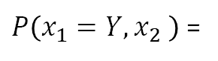
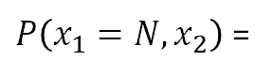
Joint Probability “Distributions” by the Chain Rule
Y | 0.55
N | 0.45
$P\left(x_{1}=Y,x_{2} \right)$ =
Y | 0.54
N | 0.46
Y | 0.53
N | 0.47
$P\left(x_{1}=N,x_{2}\right)$ =

Slide 39
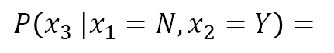
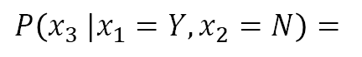
Conditional Probability Distributions
A | 0.25
B | 0.25
C | 0.25
D | 0.25
$$P\left(x_{3} |x_{1}=N,x_{2}=Y\right)=$$
Y | 0.55
N | 0.45
A | 0.3
B | 0.3
C | 0.1
D | 0.3
Y | 0.54
N | 0.46
A | 0.3
B | 0.2
C | 0.2
D | 0.3
$$P\left(x_{3} |x_{1}=Y,x_{2}=N\right)=$$
Y | 0.53
N | 0.47
A | 0.33
B | 0.22
C | 0.11
D | 0.33

Slide 40
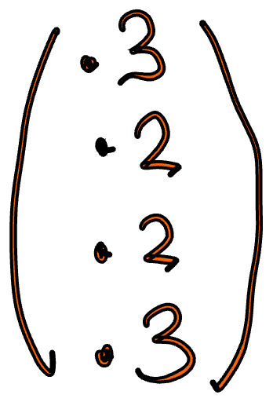
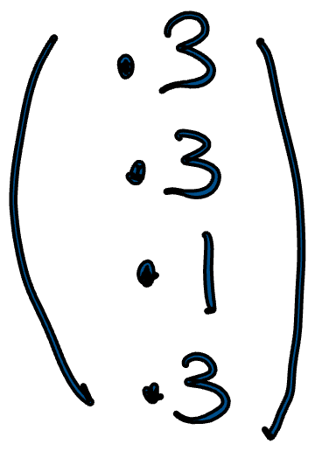
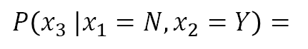
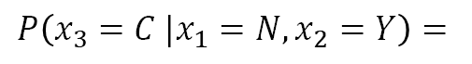
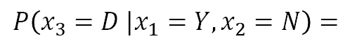
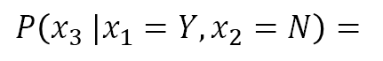
Conditional Probability Values
A | 0.25
B | 0.25
C | 0.25
D | 0.25
$$P\left(x_{3} |x_{1}=N,x_{2}=Y\right)=$$
Y | 0.55
N | 0.45
$$P\left(x_{3}=C |x_{1}=N,x_{2}=Y\right)=$$
A | 0.3
B | 0.3
C | 0.1
D | 0.3
Y | 0.54
N | 0.46
$$P\left(x_{3} |x_{1}=Y,x_{2}=N\right)=$$
A | 0.3
B | 0.2
C | 0.2
D | 0.3
$$P\left(x_{3}=D |x_{1}=Y,x_{2}=N\right)=$$
Y | 0.53
N | 0.47
A | 0.33
B | 0.22
C | 0.11
D | 0.33

Slide 41
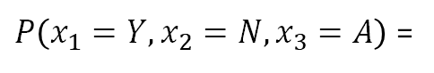
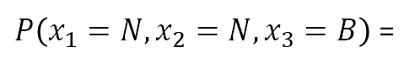
Joint Probability “Values” by the Chain Rule
A | 0.25
B | 0.25
C | 0.25
D | 0.25
Joint Probability of x1, x2, x3
= p(________, ________, ________)
= p(__________) x p(__________) x p(__________)
Y | 0.55
N | 0.45
A | 0.3
B | 0.3
C | 0.1
D | 0.3
Y | 0.54
N | 0.46
A | 0.3
B | 0.2
C | 0.2
D | 0.3
$P\left(x_{1}=Y,x_{2}=N,x_{3}=A\right)$ =
Y | 0.53
N | 0.47
A | 0.33
B | 0.22
C | 0.11
D | 0.33
$P\left(x_{1}=N,x_{2}=N,x_{3}=B\right)$ =

Slide 42
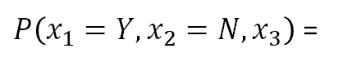
Joint Probability “Distributions” by the Chain Rule
A | 0.25
B | 0.25
C | 0.25
D | 0.25
Y | 0.55
N | 0.45
A | 0.3
B | 0.3
C | 0.1
D | 0.3
$P\left(x_{1}=Y,x_{2}=N,x_{3}\right)$ =
Y | 0.54
N | 0.46
A | 0.3
B | 0.2
C | 0.2
D | 0.3
Y | 0.53
N | 0.47
A | 0.33
B | 0.22
C | 0.11
D | 0.33

Slide 43
Calculate Joint Probability
x1
x2
Y | 0.6
N | 0.4
p(x1=B, x2=Y) = __________
a
B | 0.2
W | 0.8
p(x1=W, x2=N) = __________
b
Y | 0.3
N | 0.7
p(x1=W, x2=Y) = __________
c
🔑 1000 * sum(a+b+c) % 13 = 4 10

Slide 44
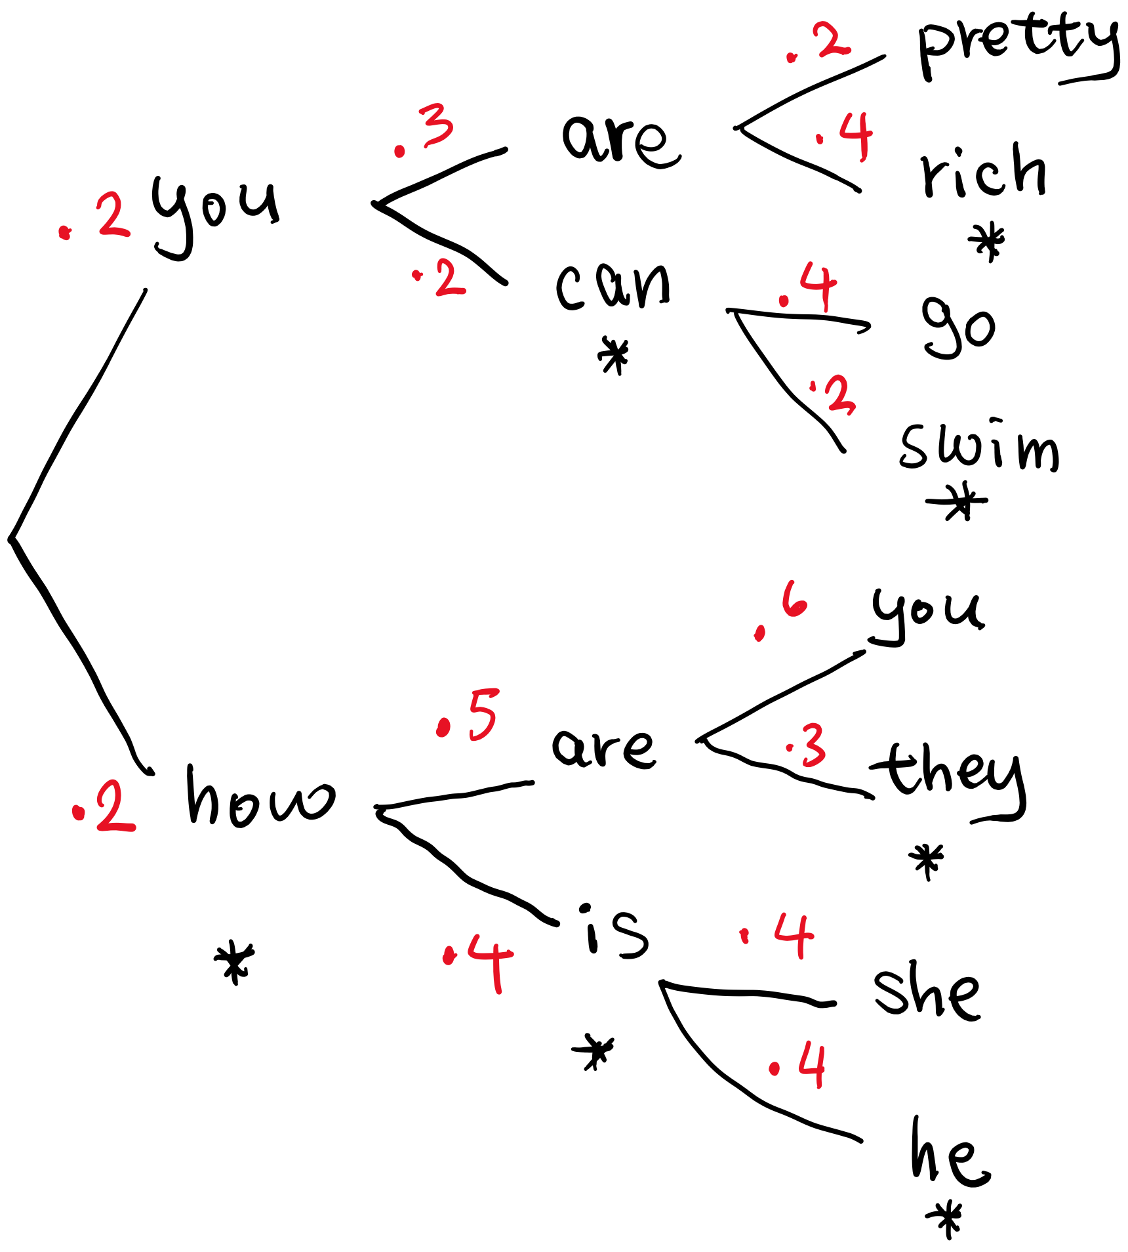
Calculate Conditional Probability
p(“rich” | “you are”) = __________
p(“swim” | “you can”) = __________
p(“she” | “how is”) = __________
p(“he” | “how is”) = __________
a
b
c
d
🔑 1000 * sum(a+b+c+d) % 13 = 9

Slide 45
Calculate Joint Probability
p(“you are rich”) = __________
p(“you can swim”) = __________
p(“how is she”) = __________
p(“how is he”) = __________
a
b
c
d
🔑 1000 * sum(a+b+c+d) % 13 = 5

Slide 46
Pixel-based Image Model

Slide 47
Color Image
C | C | B | A
B | B | B | A
B | C | B | A
B | B | B | B

Slide 48
Part Labels
1 = skin, 2 = hair
2 | 2 | 2 | 1
1 | 1 | 1 | 2
1 | 1 | 1 | 1
1 | 1 | 1 | 1

Slide 49
Generative Image Model (Joint Probability)
1 = skin, 2 = hair
C | C | B | A
B | B | B | A
B | C | B | A
B | B | B | B
2 | 2 | 2 | 1
1 | 1 | 1 | 2
1 | 1 | 1 | 1
1 | 1 | 1 | 1

Slide 50
Tree Representation
1 = skin, 2 = hair
C | C | B | A
B | B | B | A
B | C | B | A
B | B | B | B
2 | 2 | 2 | 1
1 | 1 | 1 | 2
1 | 1 | 1 | 1
1 | 1 | 1 | 1

Slide 51
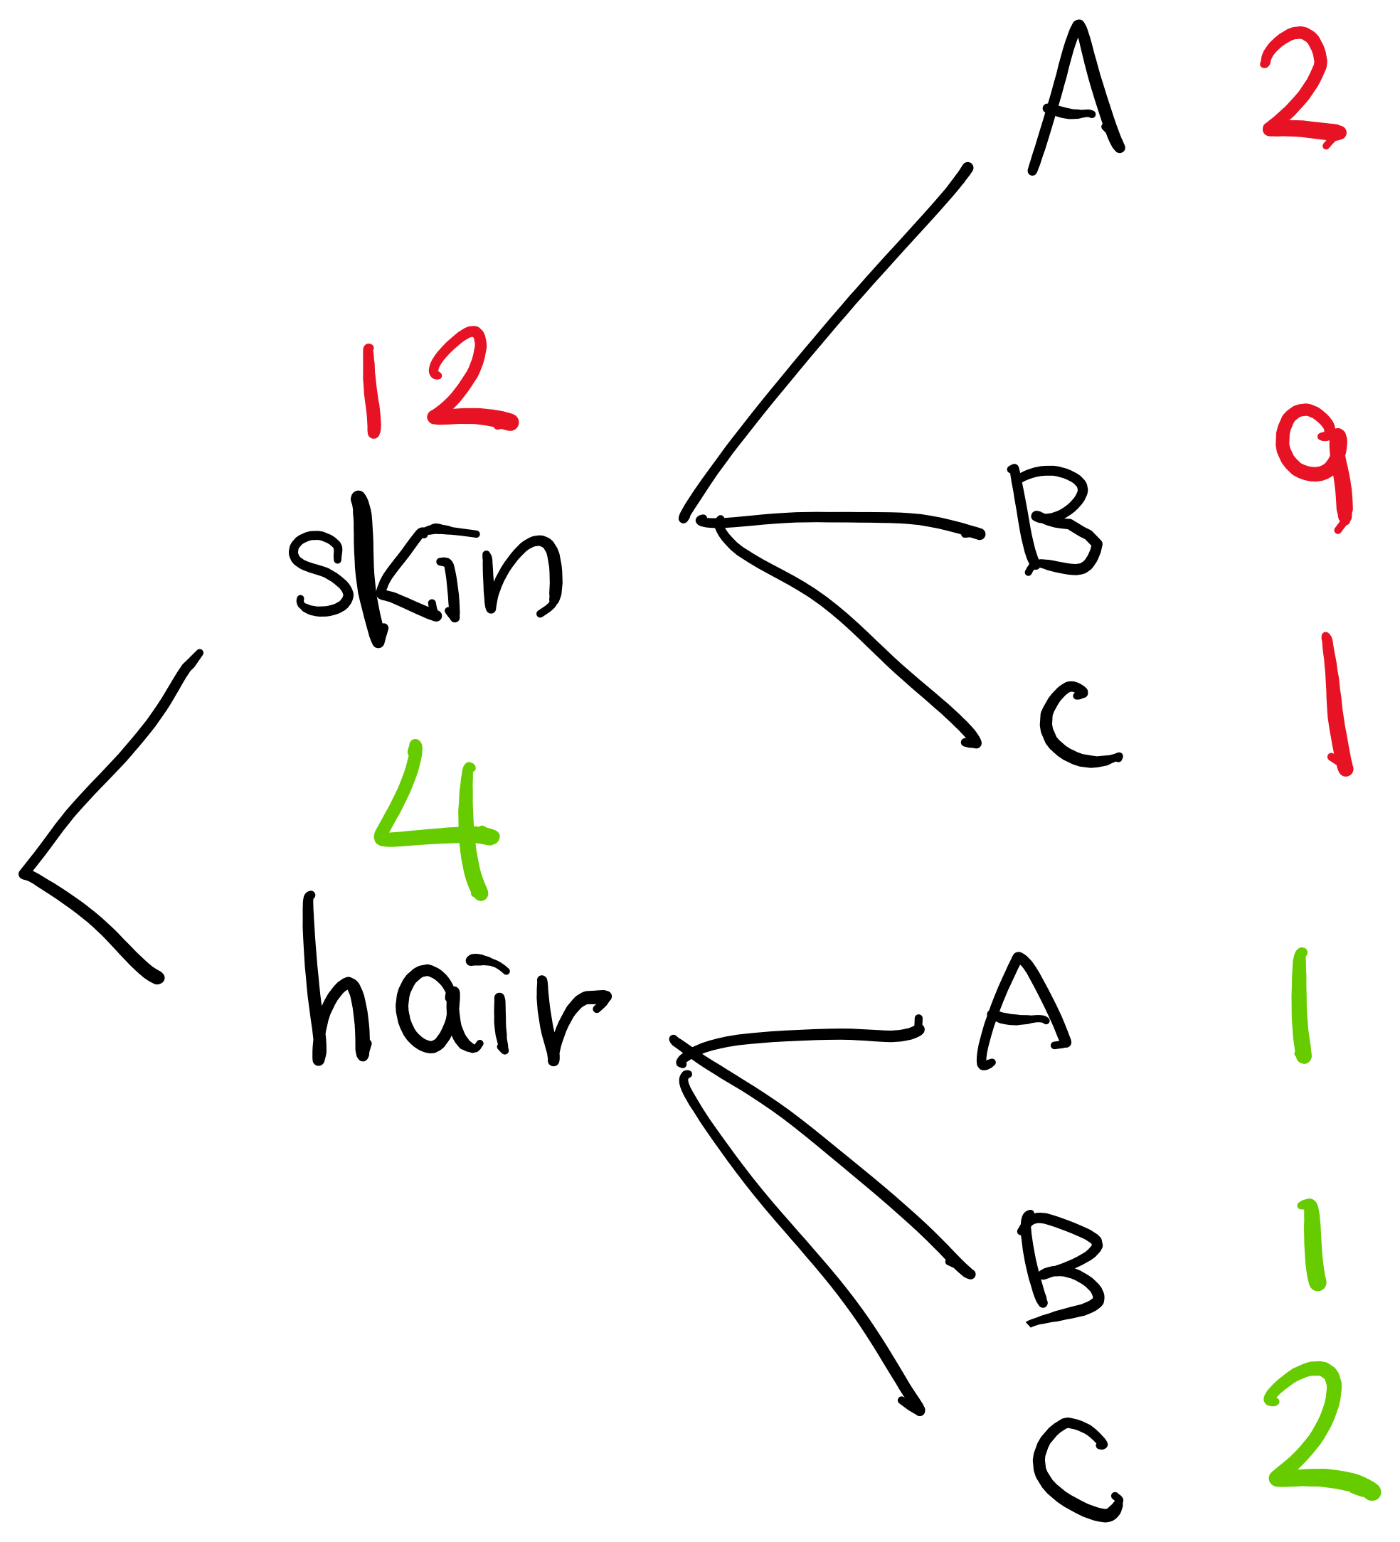
Conditional Probability Distribution
p( color | part = skin) =
p( color | part = hair) =

Slide 52
Conditional Probability Values
p( color = A | part = skin) =
p( color = B | part = hair) =

Slide 53
Joint Probability Distribution
p( color, part = skin) =
p( color, part = hair) =

Slide 54
Joint Probability Values
p( color = A, part = skin) =
p( color = B, part = hair) =

Slide 55
Fill the aggregation tree
b
white
blue
green
brown
1 = sky, 2 = land
1 | 1 | 1 | 1 | 1
1 | 1 | 1 | 1 | 2
1 | 2 | 2 | 2 | 2
2 | 2 | 2 | 2 | 2
2 | 2 | 2 | 2 | 2
a
sky
land
c
white
blue
green
brown
🔑 too easy

Slide 56
Conditional Probability Values
a
p(color = blue| part = sky) =
1 = sky, 2 = land
1 | 1 | 1 | 1 | 1
1 | 1 | 1 | 1 | 2
1 | 2 | 2 | 2 | 2
2 | 2 | 2 | 2 | 2
2 | 2 | 2 | 2 | 2
b
p(color = blue| part = land) =
c
p(color = white| part = sky) =
d
p(color = green| part = land) =
🔑 numerator(a) + denominator(b) + numerator(c) + denominator(d) = 13 -> 25

Slide 57
Joint Probability Values
(Simplify the fractions)
a
p(color = blue, part = sky) =
1 = sky, 2 = land
1 | 1 | 1 | 1 | 1
1 | 1 | 1 | 1 | 2
1 | 2 | 2 | 2 | 2
2 | 2 | 2 | 2 | 2
2 | 2 | 2 | 2 | 2
b
p(color = blue, part = land) =
c
p(color = white, part = sky) =
d
p(color = green, part = land) =
🔑 numerator(a) + denominator(b) + numerator(c) + denominator(d) = 40 -> 60

Slide 58
Autoregressive Image Model

Slide 59
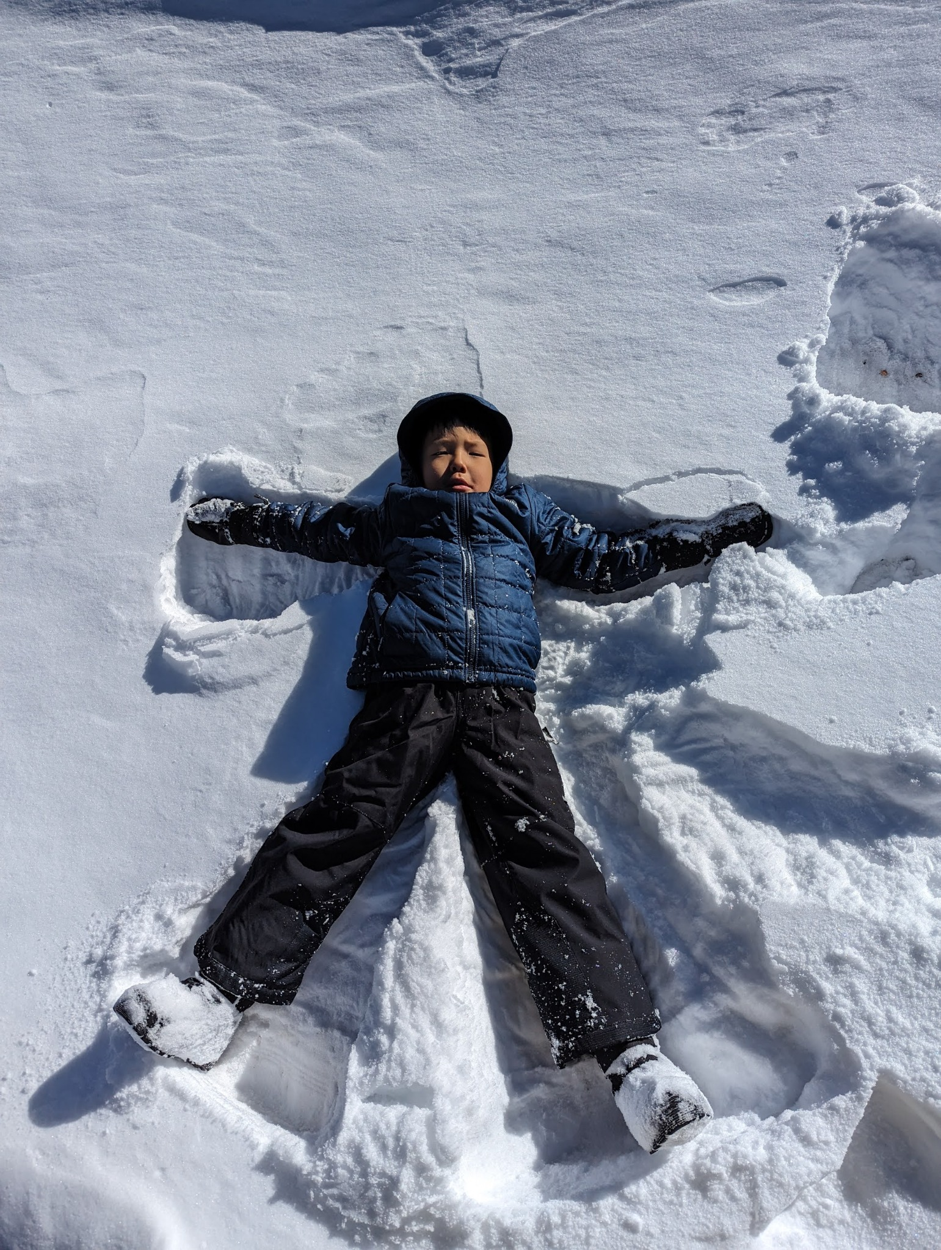
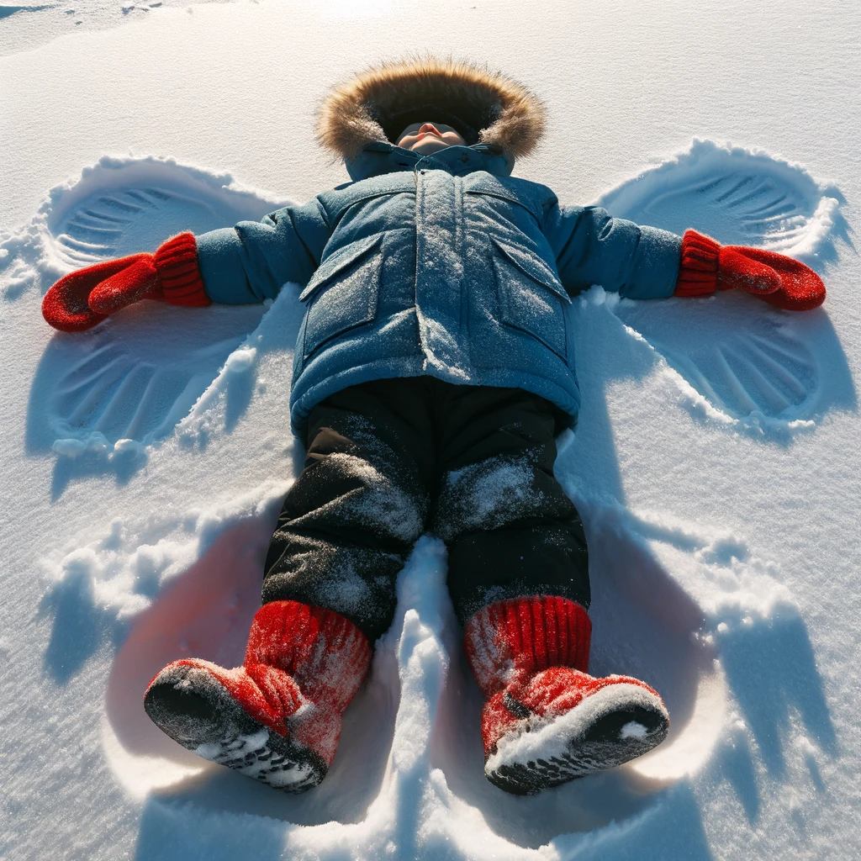
What would AI draw next?
Prompt: First, describe the scene in this photo. Second, add the most probable object to the scene.
Input Image
Text Response
Generated Image
First, the photo depicts a child lying on the snow with arms and legs spread out, likely making a snow angel. The child is wearing a blue jacket with a hood and black snow pants. The sun is shining, and the sky seems clear, suggesting it's a bright winter day. The child's expression is difficult to discern, but they appear to be looking directly at the camera. There are traces of previous activity in the snow around the child, including what seem to be footprints and marks in the snow.
Second, the most probable object to add to this scene would be a pair of brightly colored mittens on the child's hands, which are commonly worn during snow play to keep hands warm and dry. Let's proceed with adding this object to the scene.
The scene has been enhanced with the addition of a pair of bright red mittens on the child's hands, contributing to the playful and colorful aspect of the winter activity.

Slide 60

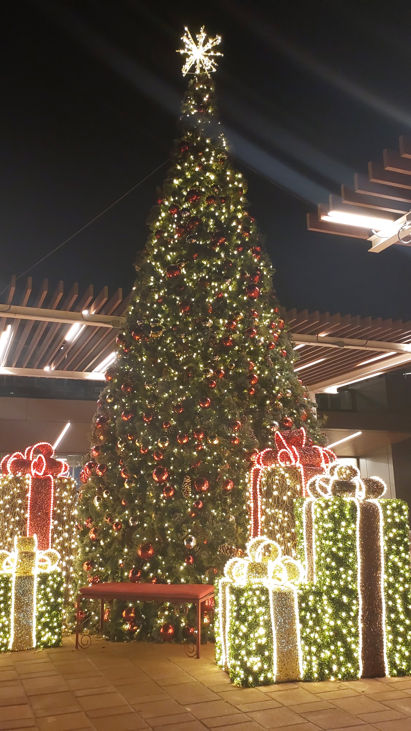
What would AI draw next?
Input Image
Generated Image

Slide 61
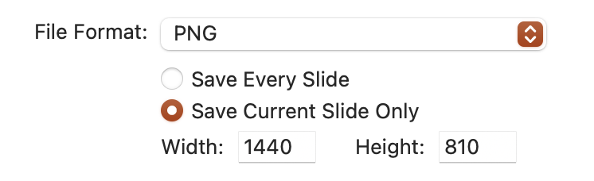
Share your finding
Export the previous slide with your images as a PNG image
Increase the width to 1440 so that the image can be seen more clearly.
Add a comment to the activity post
Attach your image to the comment
Note: This counts as a separate activity. It is entirely up to you whether or not you want to share.

Slide 62
What to draw next?

Slide 63
Sketch Tree

Slide 64


Conditional Probability
p( | )=
p( x4| )=
p( | )=
p( x4| )=

Slide 65




Joint Probability
p( )=
p( )=
p( )=
p( )=

Slide 66
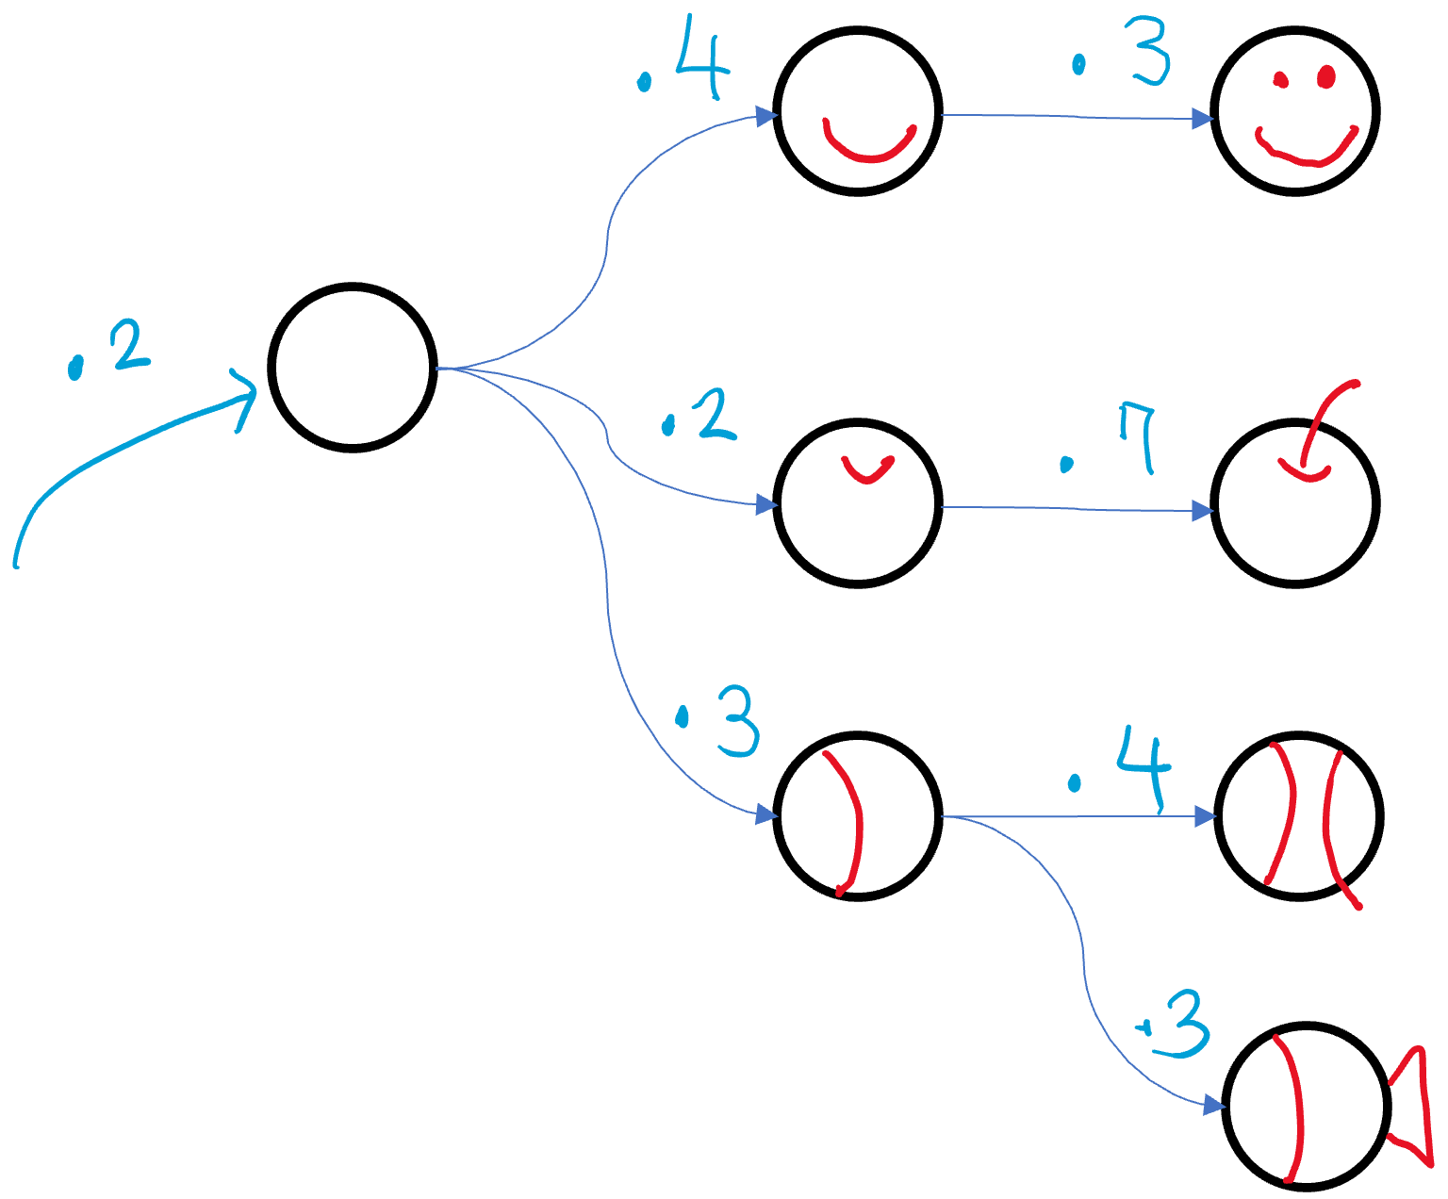
Joint Probability
p( )=
a
p( )=
b
p( )=
c
p( )=
d
🔑 (a + b + c + d) * 1000 % 13 = 3

Slide 67
NumPy by Hand ✍️ [Entropy]

Slide 68
Cross Entropy by @
p
q
.7 | .3
0 | .5
.3 | .1
0 | .1
g = -1 * np.log(q)
pt = np.transpose(p)
CE = pt @ g
-log(0) ≈32
-log(0.1) ≈ 3
-log(0.3) ≈ 2
-log(0.5) ≈ 1
-log(0.7) ≈ 0.5
-log(0.9) ≈ 0.2
-log(1) = 0

Slide 69
Cross Entropy by *
p
q
.7 | .3
0 | .5
.3 | .1
0 | .1
g = -1 * np.log(q)
pg = p * g
CE = np.sum(b)
-log(0) ≈32
-log(0.1) ≈ 3
-log(0.3) ≈ 2
-log(0.5) ≈ 1
-log(0.7) ≈ 0.5
-log(0.9) ≈ 0.2
-log(1) = 0

Slide 70
Categorical CE
p
q
0 | .3
1 | .5
0 | .1
0 | .1
g = -1 * np.log(q)
pt = np.transpose(p)
CE = pt @ g
-log(0) ≈32
-log(0.1) ≈ 3
-log(0.3) ≈ 2
-log(0.5) ≈ 1
-log(0.7) ≈ 0.5
-log(0.9) ≈ 0.2
-log(1) = 0

Slide 71
Categorical CE
p
q
0 | .3
1 | .5
0 | .1
0 | .1
g = -1 * np.log(q)
pg = p * g
CE = np.sum(pg)
-log(0) ≈32
-log(0.1) ≈ 3
-log(0.3) ≈ 2
-log(0.5) ≈ 1
-log(0.7) ≈ 0.5
-log(0.9) ≈ 0.2
-log(1) = 0

Slide 72
Batch Categorical CE
.3 | .1 | .1
.5 | .5 | .1
.1 | .3 | .5
.1 | .1 | .3
1 | 0 | 0
0 | 1 | 0
0 | 0 | 0
0 | 0 | 1
g = -1 * np.log(q)
pg = p * g
CE = np.sum(pq)
q
p
-log(0) ≈32
-log(0.1) ≈ 3
-log(0.3) ≈ 2
-log(0.5) ≈ 1
-log(0.7) ≈ 0.5
-log(0.9) ≈ 0.2
-log(1) = 0

Slide 73
Batch Categorical CE
.3 | .1 | .1
.5 | .5 | .1
.1 | .3 | .5
.1 | .1 | .3
0 | 1 | 3
q1 = q[c, [0,1,2]]
g = np.log(q1)
CE = np.sum(g)
q
c
-log(0) ≈32
-log(0.1) ≈ 3
-log(0.3) ≈ 2
-log(0.5) ≈ 1
-log(0.7) ≈ 0.5
-log(0.9) ≈ 0.2
-log(1) = 0

Slide 74
Binary Cross Entropy
y
.7
1
q = np.vstack((y, 1 – y))
p = np.vstack((t, 1-t))
g = -np.log(q)
pg = p * g
CE = np.sum(pg)
t
-log(0) ≈32
-log(0.1) ≈ 3
-log(0.3) ≈ 2
-log(0.5) ≈ 1
-log(0.7) ≈ 0.5
-log(0.9) ≈ 0.2
-log(1) = 0

Slide 75
Batch BCE
y
.7 | .3 | .9
1 | 0 | 1
q = np.vstack((y, 1 – y))
p = np.vstack((t, 1-t))
g = -np.log(q)
pg = p * g
CE = np.sum(pg)
t
-log(0) ≈32
-log(0.1) ≈ 3
-log(0.3) ≈ 2
-log(0.5) ≈ 1
-log(0.7) ≈ 0.5
-log(0.9) ≈ 0.2
-log(1) = 0

Slide 76

BCE
y
.3 | .1 | .7 | .9 | 0 | 1
1 | 0 | 0 | 0 | 1 | 1
t
q = np.vstack((y, 1 – y))
p = np.vstack((t, 1-t))
g = -np.log(q)
pg = p * g
CE = np.sum(pg)
q
p
g
-log(0) ≈32
-log(0.1) ≈ 3
-log(0.3) ≈ 2
-log(0.5) ≈ 1
-log(0.7) ≈ 0.5
-log(0.9) ≈ 0.2
-log(1) = 0
pg
Show your work
CE
🔑 CE * 10 % 7 = 3

